Slide 1

how to optimize insurance billing via coding and documentation
August 30, 2023

Slide 2

How to optimize insurance billing via coding and documentation
By Dr Wafaa Elshayeb
August 30, 2023
Date

Slide 3

How to maximize insurance billing via coding & documentation
Objectives of this module:
To give our medical team awareness about Health Insurance documentation in KSA according to CCHI and how to maximize insurance billing via coding and documentation
billing via coding and documentation

Slide 4
How to maximize insurance billing via coding & documentation
Documentation strategy CDI
Full history :-
Chief Complaint ,History of Present Illness ,Past Medical History , Focus on clinical findings
Medical necessity :-
Justify all services and medications
Avoid Defensive Medicine :-
The combined supplements
Write Specific ICD 10 code
Accurate and detailed management plan
with duration and expected outcomes
Avoid the uncovered ICD10 :-
Obesity E66 , L70 acne , L66 hair loss , L21 seborrheic dermatitis ,infertility N46,N97 )
billing via coding and documentation
Provisional or 1ry diagnosis
As it is supported by clinical data radio or labs will confirm or exclude it
CCHI new policies awareness
(newly added benefits , amended benefits)
Avoid excessive ordering :- follow the initial work up protocols
Cause of rejection if we didn't follow (early as per given data )

Slide 5
How to optimize insurance billing via coding & documentation
ICD10 Codes
Specific Code
Primary Code
Non-Specific Code
Secondary Code
Hypertension
Fever
Gastroenteritis
Vomiting
Tonsilitis
Cough

Slide 6
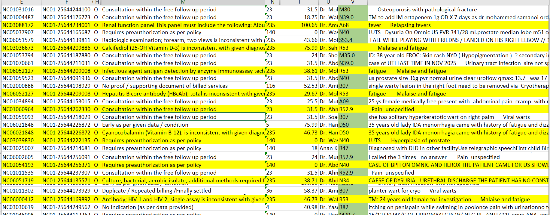
Example of the most common causes of in appropriate clinical data

Slide 7
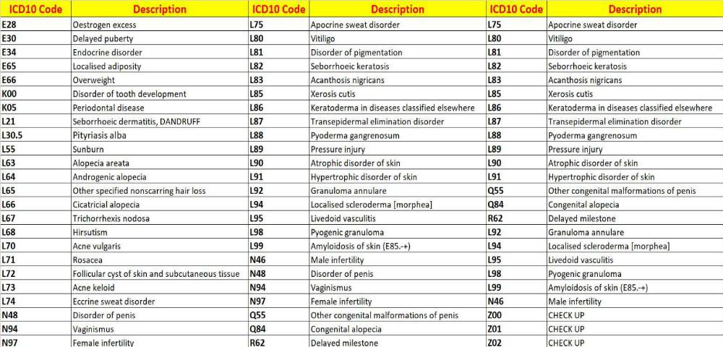
The most common Uncovered conditions ICD 10
billing via coding and documentation

Slide 8
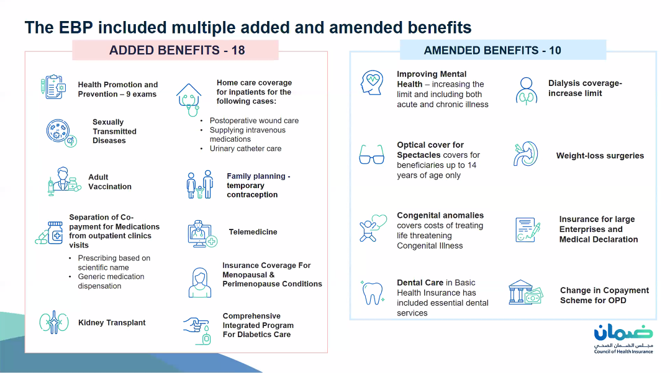

Slide 9
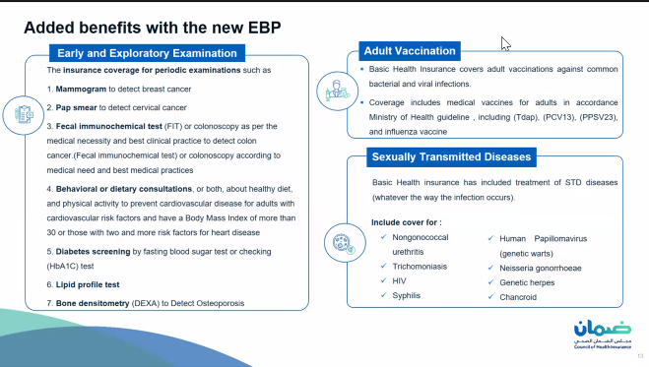

Slide 10
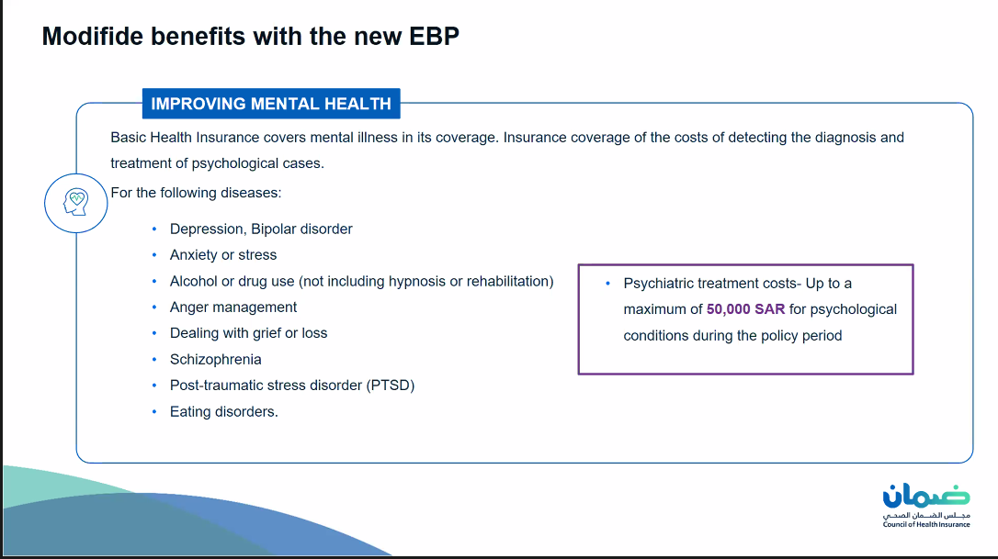

Slide 11
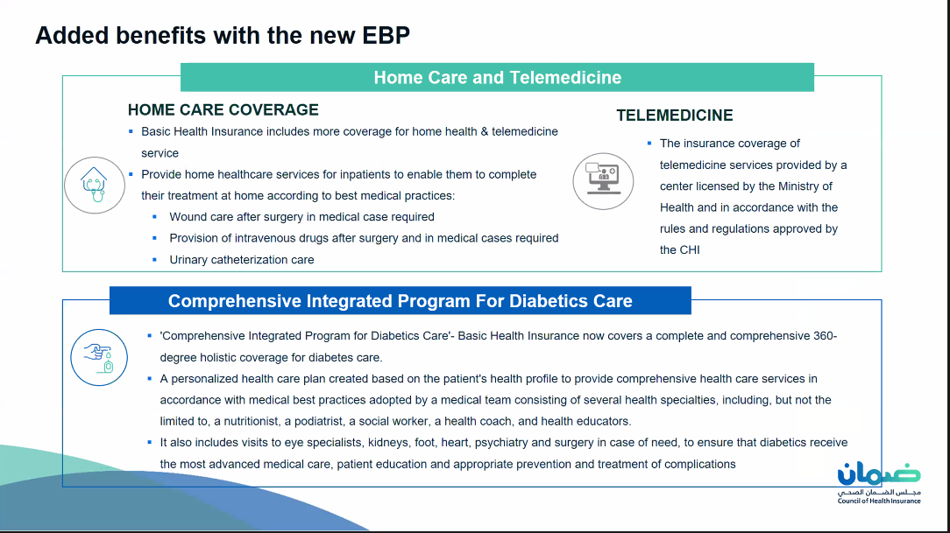

Slide 12
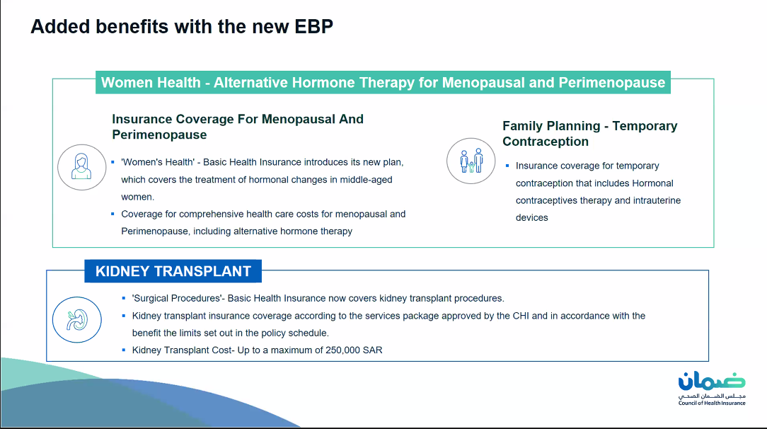

Slide 14


